Slide 1
ArchiveAI
Multimodal AI for the Living Tradition

Slide 2
Unique Challenges
Multiple Modalities
Open Corpus
Hyperspecific use-cases

Slide 3

Speech Recognition
Audio -> Text
Multi-model system
Diarization
Speaker filtering
<30% Word Error Rate is the bar

Slide 4

Machine Translation
Text -> Text
One source, many targets
Style is difficult

Slide 5

Speech Synthesis
Text -> Audio
Accessibility concerns
Accent selection
Pronunciation issues
Selecting appropriate tones

Slide 6

Summarization
Done by LLM
Cross-lingual application

Slide 7

Post Editing
Used for Speech Recognition, Translation, Summarization
Can be automated with LLMs

Slide 8
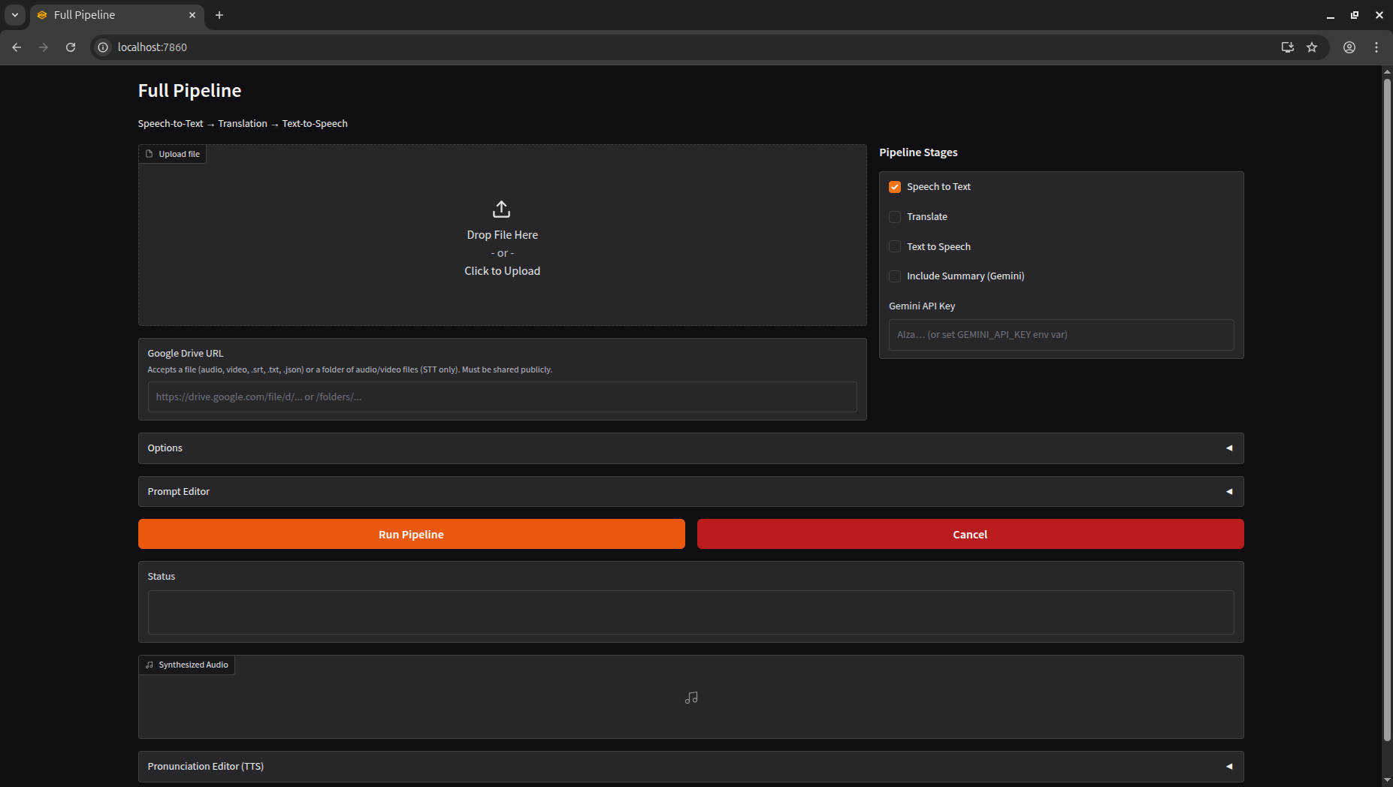

Slide 9
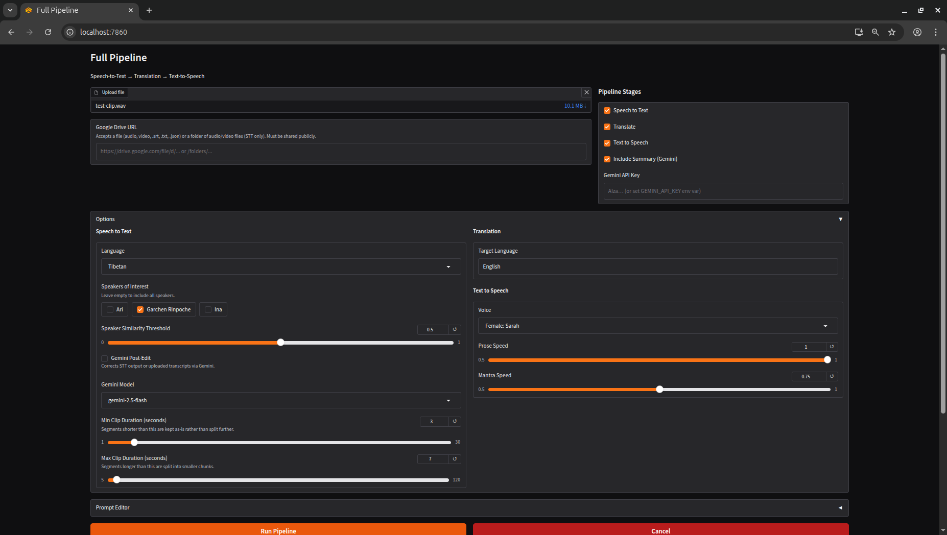

Slide 10
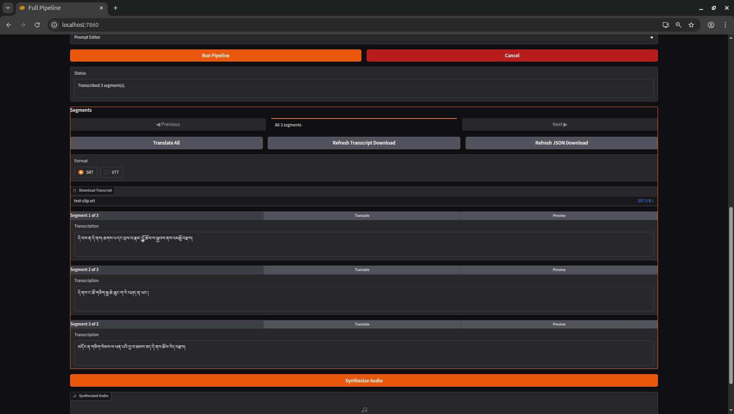

Slide 11
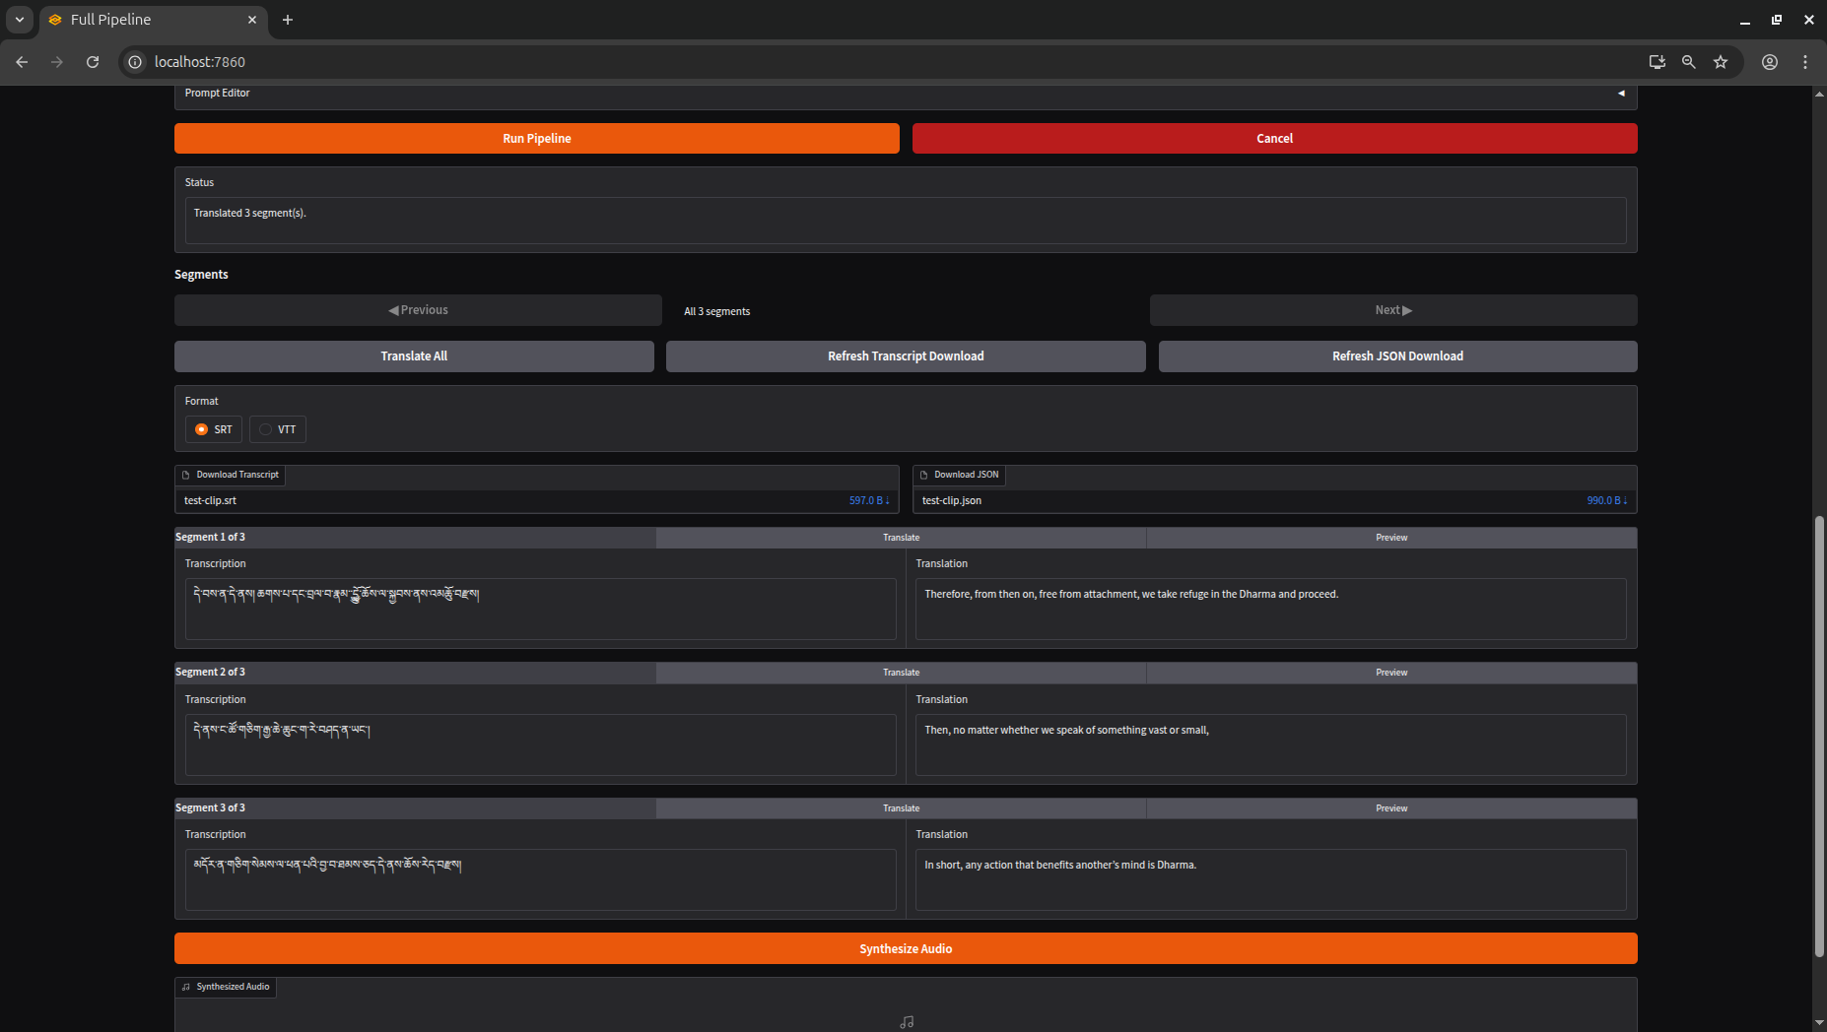

Slide 12
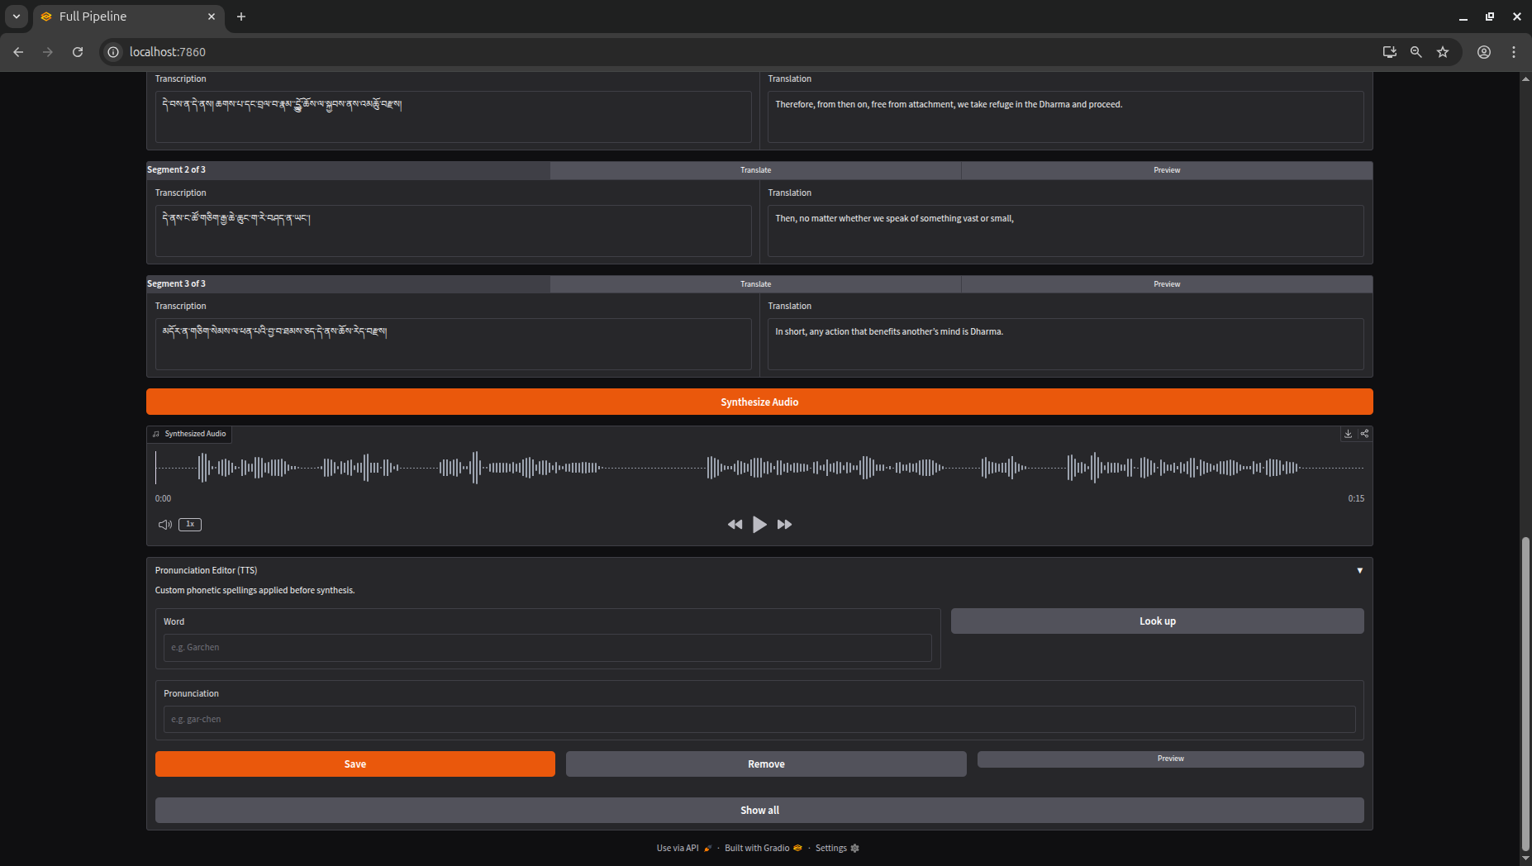

Slide 13
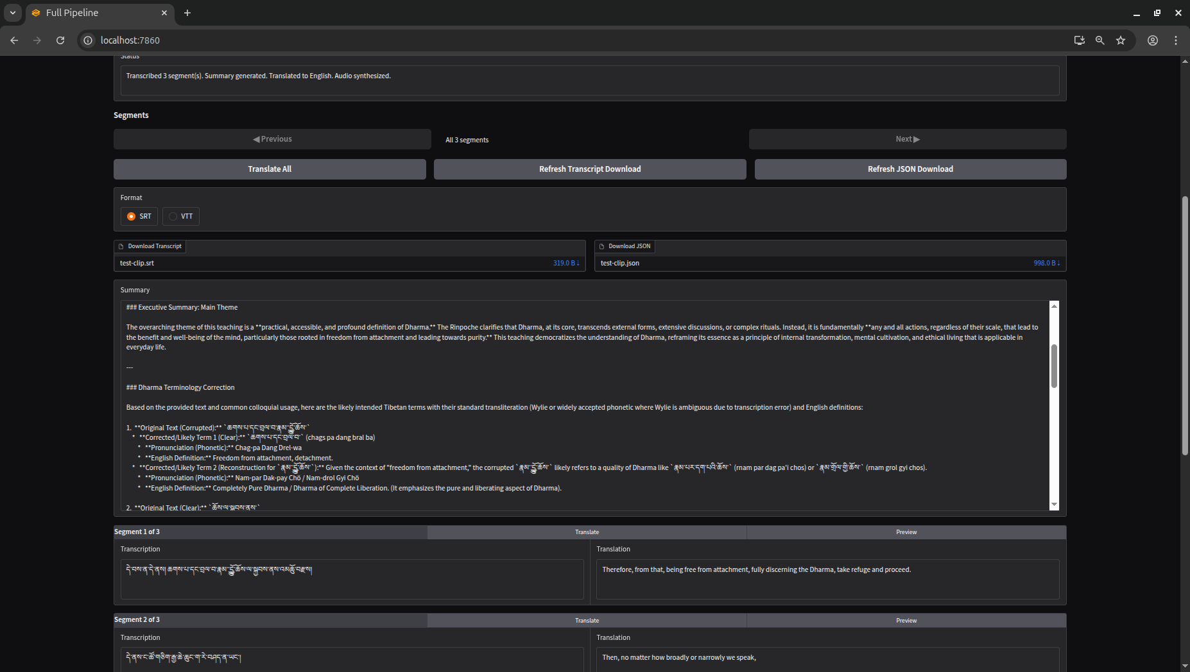

Slide 14
Summary Excerpt
**3. Core Instructions: The Essence of Dharma (Lojong & Sila)**
* **Transcript Line 3 Interpretation:** `མདོར་ན་གཅིག་སེམས་ལ་ཕན་པའི་བྱ་བ་ཐམས་ཅད་དེ་ནས་ཆོས་རེད་བརྫས།`
* **Content:** This is the central teaching. The Rinpoche succinctly defines Dharma as **"all actions that are beneficial to the mind."** This instruction strongly aligns with:
* **Mind Training (Lojong):** The entire practice of Lojong is about transforming the mind through beneficial actions and thoughts.
* **Ethics (Sila):** Actions beneficial to the mind are inherently ethical, promoting positive conduct and preventing harm.
* While Wisdom (Prajna) is the ultimate goal, this section emphasizes the practical, day-to-day engagement with Dharma through mental and behavioral transformation.

Slide 15
ArchiveAI
Multimodal AI for the Living Tradition

